Slide 1
CAPSTONE PROJECT – RED BUS
BY KAVITHA THANASEKARAN

Slide 2
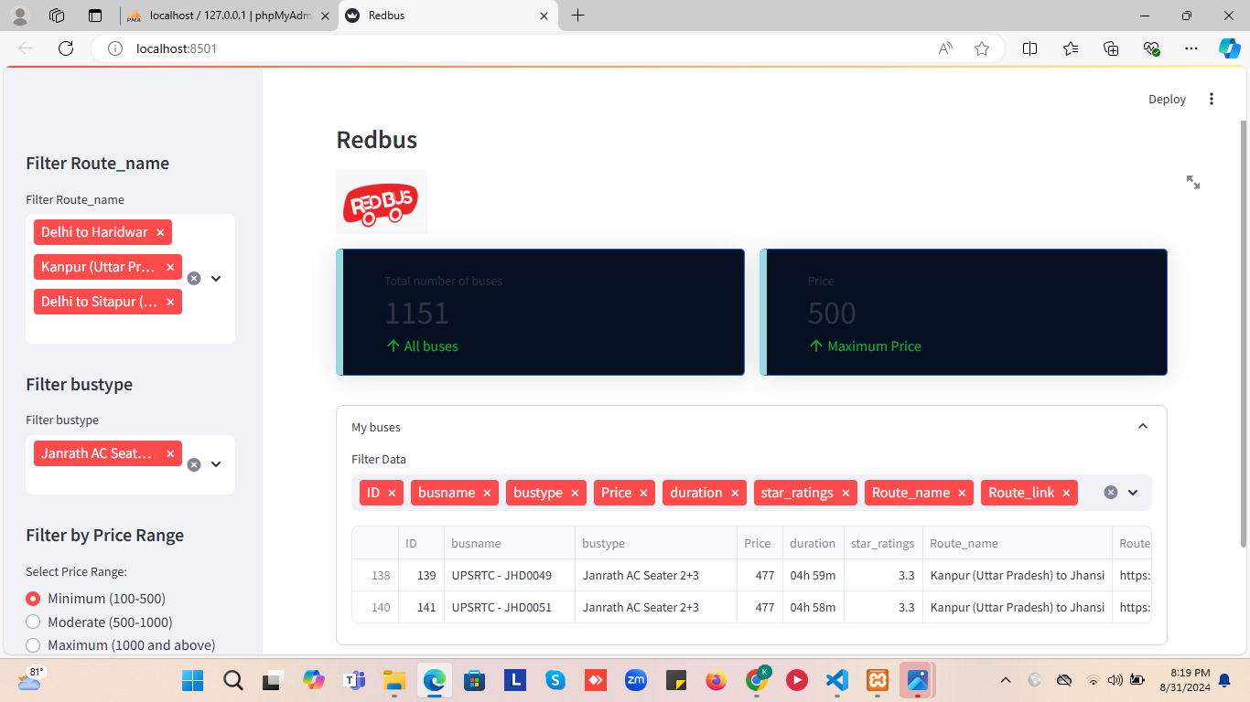

Slide 3
RED BUS
Red bus is an Indian bus ticket booking platform which facilitates through its website. This platform offers a simple and intuitive interface ,allowing users to easily search for buses by entering their departure, travel data and destination points. It also provides secure payment options.

Slide 4

RED BUS
Data scraping using selenium-inserting data into MYSQL database- creating web app using streamlit

Slide 5


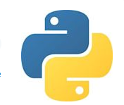
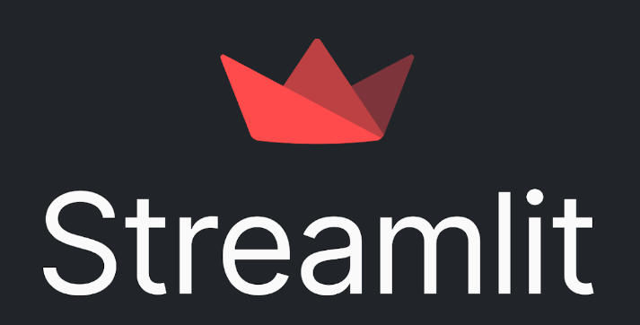

TECHNOLOGIES USED
Python
Pandas
Selenium
Streamlit

Slide 6
Packages & libraries used
Pandas as pd
mysql.connector
datetime
Streamlit as st
Webdriver
style_metric_cards

Slide 7
SELENIUM
Selenium is a powerful tool for web browser which is especially useful for web scraping. I used this tool to scrape data like bus type, bus name, reaching time, departing time, price, route name and route link from redbus website.

Slide 8
MYSQL database
After the data scrapping is over, I converted the data into pandas data frame. Using MySQL connector (xampp server) I created new data base – redbus and table named busdettable . Using SQL queries inserted all the data into the data base. The data could be accessed from the data base for further steps.

Slide 9
STREAMLIT
With the reference to the streamlit documentation, I used some functions like (subheader, image, sidebar, metric spaces, radio ) to create the user-friendly interactive application similar to the redbus where I have provided filtering options for route name, bustype and the price.

Slide 10
THANK YOU

